Slide 1
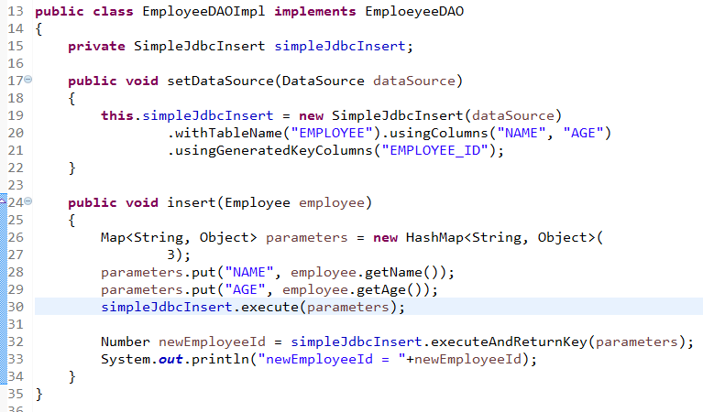
Specifying columns for a SimpleJdbcInsert
We can limit the columns for an insert by specifying a list of column names with the usingColumns method

